Slide 1

Distributed Computing Systems
CSE 707 Fall 2021 Paper Presentation AUTONLU: An On-demand Cloud-based Natural Language
Understanding System for Enterprises
Submitted By
Name: ID:
Arnob Kumar Dey 21166011
Hasan Muhammed Zahidul Amin 21166019
Junaid Bin Kibria 21166022
Al Hasib Mahamud 21366007
A. N. M. Sajedul Alam 21366032
Submitted To
Annajiat Alim Rasel
Sr. Lecturer and Deputy Director,
Institutional Quality Assurance Cell,
Department of Computer Science & Engineering

Slide 2
Introduction
Ease of use
State-of-the-art models
Scalability

Slide 3
Related Work
Toolkits and frameworks designed to provide a suite of state-of-the-art NLP models. (Gong et al., 2019; Akbik et al., 2019; Wang et al., 2019; Zhu et al., 2020; Qi et al., 2020).
Do not have a user-friendly interface.
Not explicitly designed for enterprise settings.
Google introduced AutoML Natural Language.
The proposed system is different from AutoML.

Slide 4
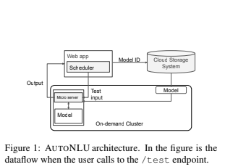
AUTO NLU
Components and Architecture
A web application: works as the frontend to the users
A cloud storage system: to hold the data
An on demand cluster: for training and testing

Slide 5
AUTO NLU(continuation)
Instance Image
Web-server is configured to serve the following endpoints:
/train that connects to the training code of the underlying model.
/is free that returns various information about the utilization of the instance
/test that connects to the testing code of the underlying model.
/notebook that connects to the Jupyter Lab notebook’s URL packaged in the image.

Slide 6
User Interface
Database Tool
Analysis Tool
Research Management Tool

Slide 7
Database Tool
An intermediate representation (IR) which is suitable for NLU tasks and write frontends to convert common dataset formats
A converter to converts IR back into other dataset formats
Visualizing and editing data points are straightforward and do not depend on the source

Slide 8
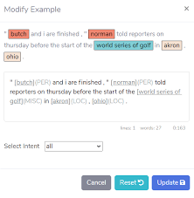
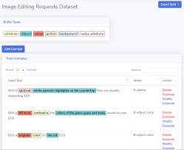
Database Tool
Figure: Dataset View of AutoNLU
Figure: Edit/ Add a datapoint

Slide 9
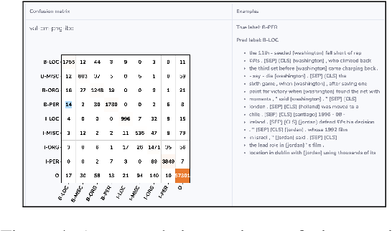
Analysis Tool
TensorBoard is included in prebuilt images to display common training metrics
Interactive views to analyze the trained results
Figure: Interactive confusion matrix

Slide 10
Resource Management Tool
In most cases AutoNLU automatically handle resource management for the users
Provided functionalities are
I. An instance with a desired hardware configuration and docker images
II. Assigning a task to an instance
III. Accessing an instance’s shell and files

Slide 11
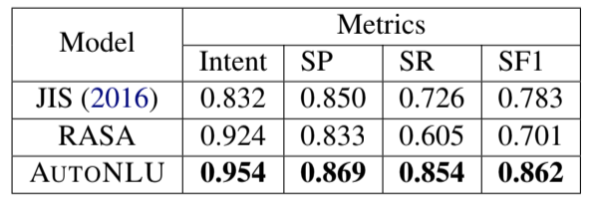
Case Studies
NLU Models for Image-Editing Requests: -Aim was to create an effective workflow to train a state-of-the-art model and clean the dataset at the same time.
Authors train a simple model using the fastest algorithm provided by AUTONLU. then fix those labeling errors,either by using the dataset interface in AUTONLU, or by writing scripts. With this new dataset, here they retrain another model and repeat the process.
Results on the image-editing requests dataset.Intent accuracy, slot precision, slot recall, and slot F1 scores are reported. Scores of AutoNLU models are averaged over three random seeds.

Slide 12
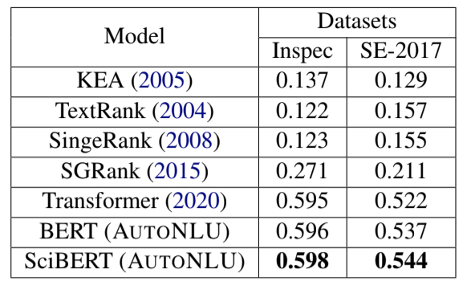
Case Studies
Keyphrase Extraction Models Models: -This is a problem of great interest to the Document Cloud team of Adobe. In this case study, authors aim to develop an effective keyphrase extraction system for the team.
formulate the task as a sequence labeling task. Given an input sequence of tokens x = {x1, x2, ..., xn}, the goal is to predict a sequence of labels y = {y1, y2, ..., yn} where yi ∈ {B, I, O}.
Results on Inspec and SE-2017 datasets. F1 scores are reported. Scores of this models are averaged over three random seeds.

Slide 13
Conclusion & Future Work
Conclusion
Create powerful NLU models
deep learning expertise
open-source
Future Works
Transfer Learning
Knowledge Distillation
Neural Architecture search

